Slide 1

Stove Heat
Regulator
By Dean Devereaux
Notes:
Stoves 2nd leading cause of air pollution
This can be due to misuse of air vent always keeping it closed
Heat pollution can also be a problem which can be fixed by control of the air vent

Slide 2
Vision of Project
LCD Display and Buttons
Temperature
Sensors
Air Vent with Stepper Motor
Notes:
Red pipe provides heat to radiator(flow)
Blue pipe is cooler water returning to stove to heat up(return)
When return pipe temp is close to flow pipe temp air vent will close gradually
LCD Display will display return pipe temperature

Slide 3
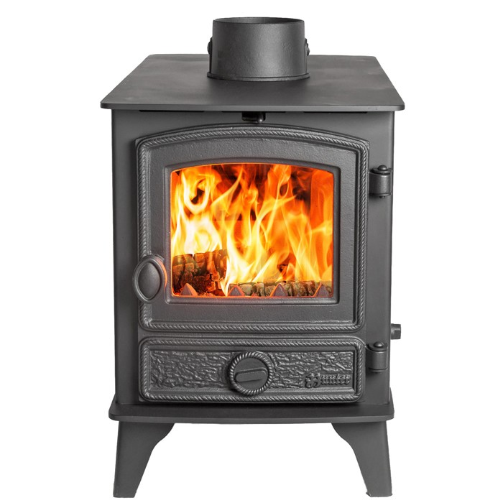
Aim of the Project
Reliable Use of Stove
Primary
Efficient Radiator Control
Secondary
Efficient Fuel Control
Out – In < 22°C
Notes:
Smart use of the stove
Primary aim is to control heat being provided to the radiators and allow no excess of heat
Secondary aim would be to control burn rate of fuel which can also be controlled with the air vent

Slide 4
Microcontroller
PIC18F452
LCD Display
Outputs
Outward Temp Sensor
Inputs
Air Vent Stepper
Motor
Inward Temp Sensor
Notes:
Decided to use PIC18F452 as I am familiar with it and I already had past work done with it

Slide 5
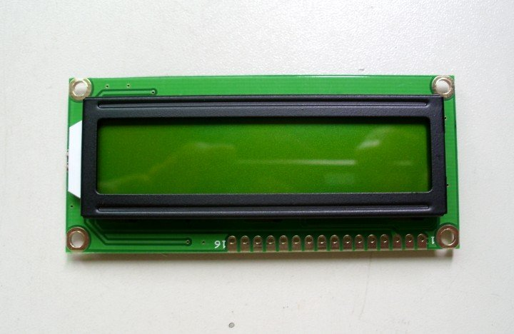
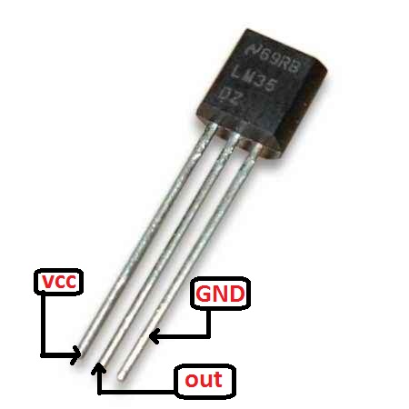
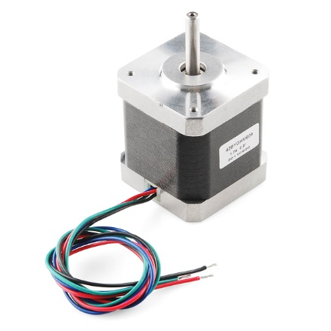
Microcontroller
PIC18F452
Outputs
Inputs
Notes:
LM35D: 0C - 100C 1C = 10mV just one wire output
Bipolar Stepper Motor: 4 inputs used with a h-bridge to allow movement in both directions
Has a high torque and low speed. Ideal for stove air vent
LCD Display: 4bit will display return pipe temperature

Slide 6
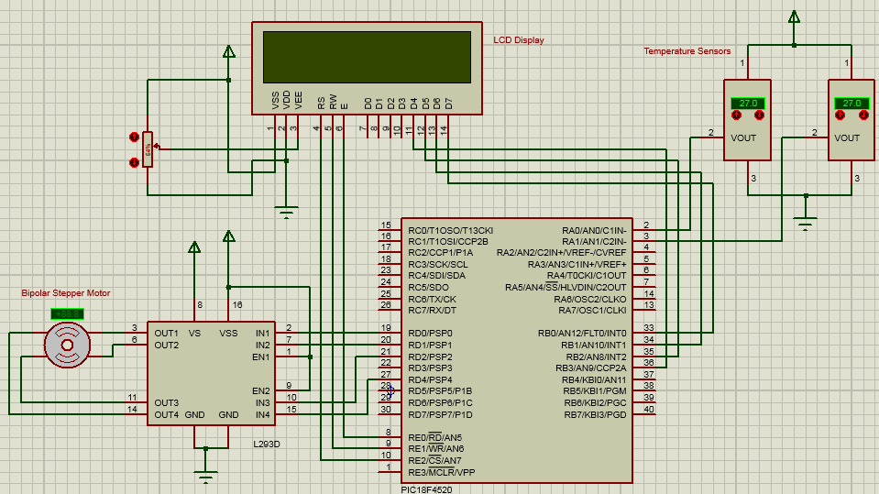
Circuit Diagram
Notes:
LCD: PORTB = Data Lines PORTE =
Motor: PORTD
Temp Sensors: Use ADC on PORTA
You will see that I’m using the PIC18f4520 here which I used in the physical circuit as it had internal oscillation

Slide 7
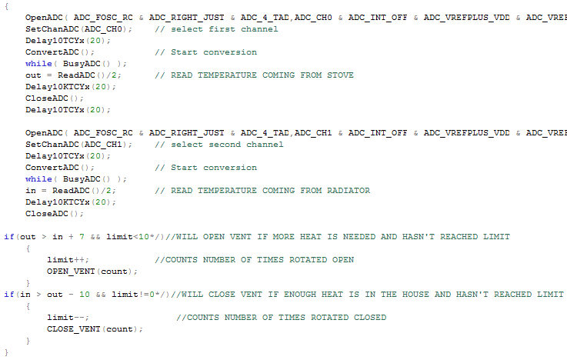
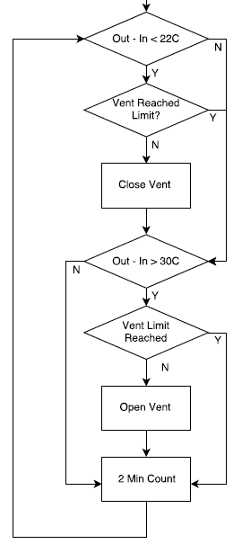
Temp Sensors Program

Slide 8
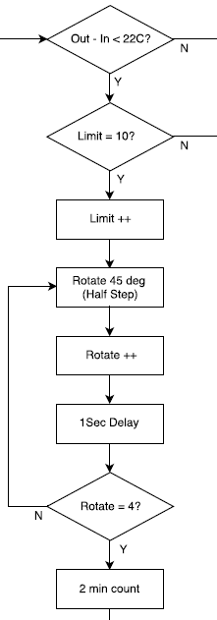
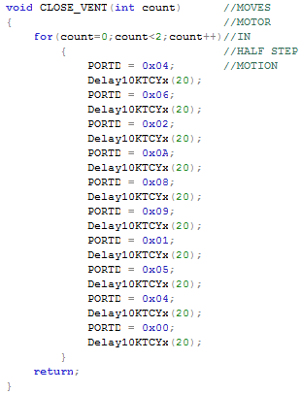
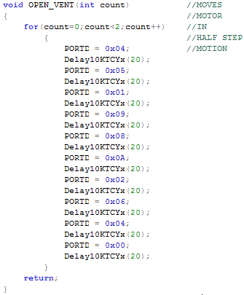
Stepper Motor Program

Slide 9
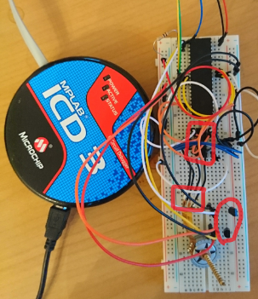
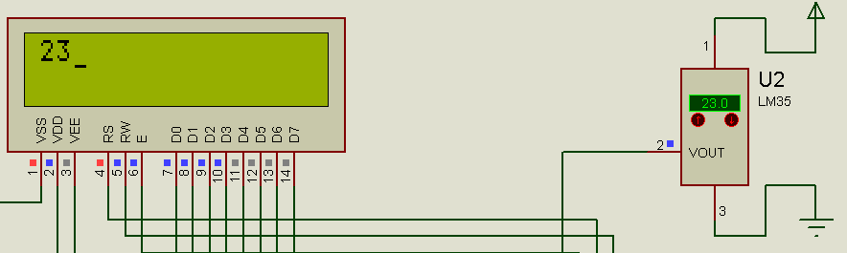
Achievements
Motor movement with Sensors
LCD Simulation
Notes:
Started using LED’s to demonstrate the motor movement before I extracted a stepper motor from a floppy disk drive
Couldn’t physically get the LCD operating but I could simulate it displaying the sensors Temperature

Slide 10

Future Work?
Two Modes
Carbon Monoxide Detection
Out–In>22°C
Room >Thres

Slide 11
Conclusion
Aim
Air Vent Movement
Efficient use of Heat and Fuel
Possible to Program
Future Development

Slide 12
Thank You Any Questions?

Slide 13
